Slide 1

SOS IM6 Test line Facility
Date: 24-Dec-2025

Slide 2

Test line for LS6: SOS
Tester line NCA HLA parameter addition and teaching
Tester line 1 ACC Booth Modification For front and rear radar
Care 2 Line booth modification for AVM and LDW
Tester line 1 DVT parameter addition

Slide 3
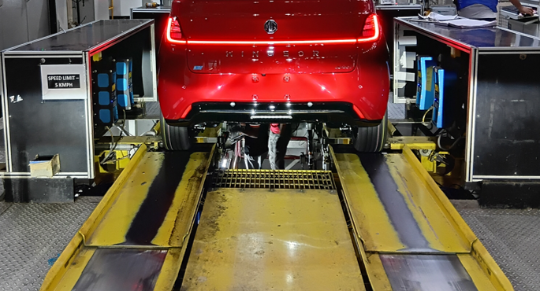
Test line for LS6: NCA/HLA & DVT
Sr No | Description | IM6 | Machine
1 | Track width | F 1698 R 1707 | 2000
2 | Width | 1988 | 2400
3 | Wheelbase | 2950 | 3200
SOS:
NCA/HLA parameters addition
NCA and head lamp teaching
DVT software changes for TPMS, Dynamic brake, VCU etc.

Slide 4
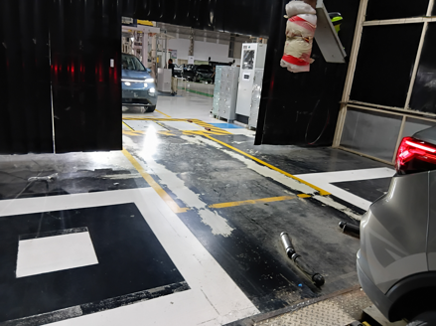
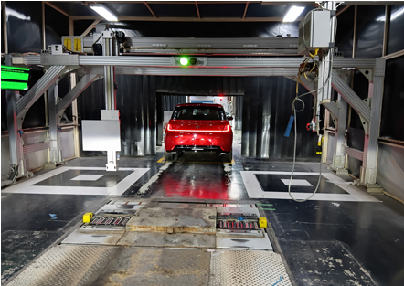
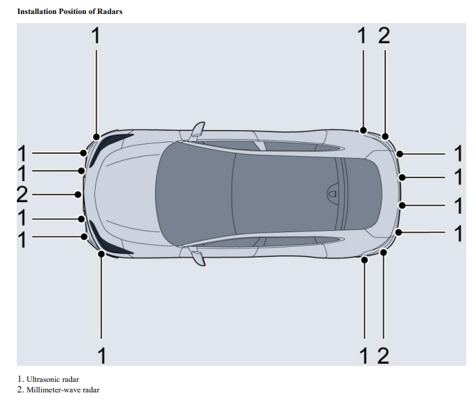
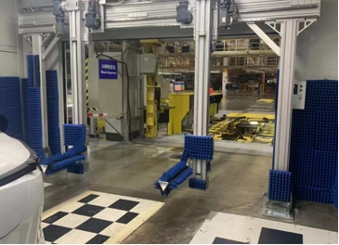
Test line for LS6: Front and rear Radar calibration
SN | Description | For IM6 | Available
1 | Rear end space required for gantry | 3400 | 4000
2 | Front target plate | 350*350 to 700*700 | 760*660
GA1 shop ACC station will be modified
for front and rear radar
SOS:
New Rear gantry with 2 target plates
Replacement of current ACC target plate
Machine software modification
Panel hardware addition and wiring
Prove out of present models with new ACC plate
MGI booth
China booth

Slide 5
Test line for LS6: Front and rear Radar calibration
Front Radar for ACC
Rear Radar for BSD

Slide 6
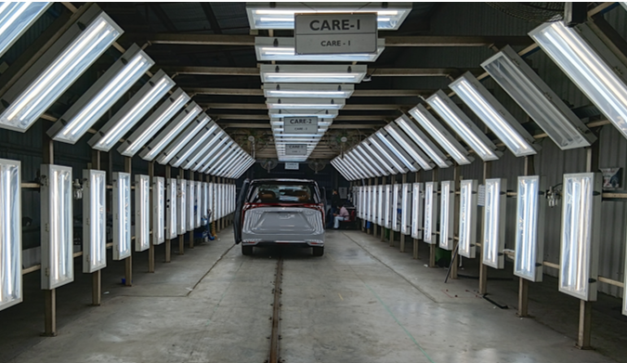
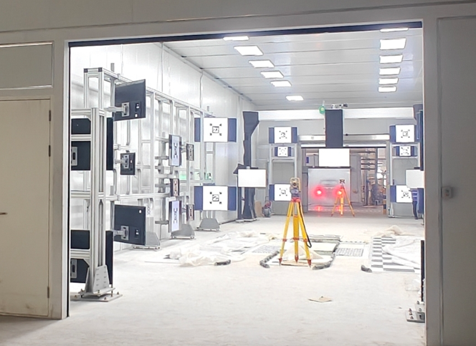
Test line for LS6: Camera calibration
Sr No | Description | For IM6 | Available at care 2
1 | Booth length | 25 meter | 27 meter
2 | Booth width | 7 meter | 5.5 meter/10 meters
3 | Booth Height | 4 meter | 3/10 meter
Current care 2 booth width and height is NOK Need to vacate booth for AVM/LDW
SOS:
Tester 2 ACC booth centering unit booth relocation to care line
AVM target patterns
New panel with PC and software
30 No of 32” screen and mounting
All Booth accessories for vehicle testing
MGI CARE 2 Booth
China AVM/LDW booth

Slide 7
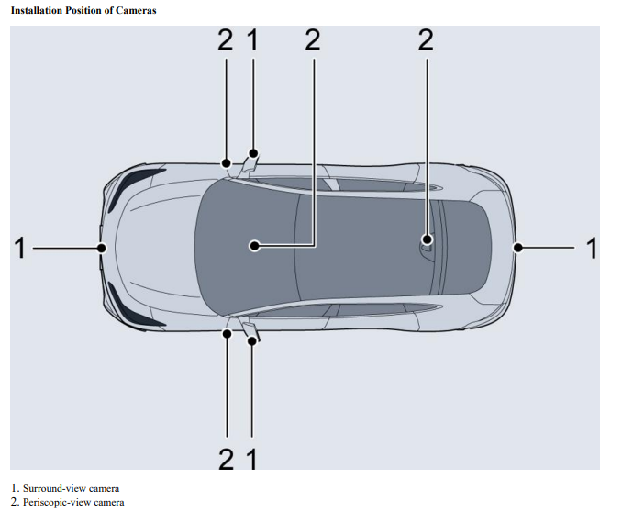
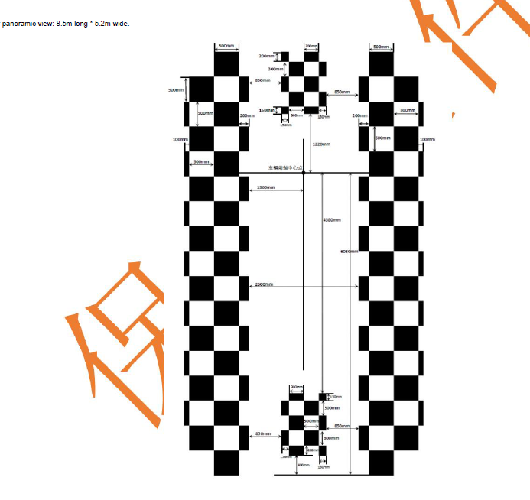
Test line for LS6: Camera calibration
LDW Camera
AVM Camera

Slide 8
THANK YOU

